Slide 1
BRIDGEPORT HOSPITAL (BC & MC)
ANATOMIC PATHOLOGY
QUALITY ASSURANCE MEETING
March 20, 2024
for the Month of February 2024

Slide 2
OLD BUSINESS
\\Ynhh.org\src\BH - Laboratory\AP - BH 38030\! AP QA\AP QA Meetings\2024\2024 AGENDA & MEETING MINUTES\March 20, 2024\minutes for month of January held on February 17, 2024.docx

Slide 3
Surgical Specimens Volume OCTOBER 2023- February 2024

Slide 4
BRIDGEPORT CAMPUS
Intraoperative Diagnosis vs. Final/ Amendments & Histology):
\\Ynhh.org\src\BH - Laboratory\AP - BH 38030\! AP QA\AP QA Meetings\2024\2024 AGENDA & MEETING MINUTES\March 20, 2024\ANATOMIC QA 3 20 2024.docx
\\Ynhh.org\src\BH - Laboratory\AP - BH 38030\! AP QA\AP QA Meetings\2024\2024 Consensus Conference\January 2024 Consensus Conference.pdf

Slide 5
Milford Campus February 2024 Frozen Stats
-Frozen: 1 - Parts that Meet Threshold: 0
-Blocks: 1
-Touch Preps: 0 -% of Parts that Meets Threshold: 0% -Cases: 1
Threshold of 20 min./ block – only one case met the 20 minutes threshold
Number of discrepancies: 0

Slide 6
SYSTEM QUALITY METRIC
FY24

Slide 7
GI Biopsy TAT 80% </= 2 business days (received to sign out)

Slide 8
Prostate TAT (received to sign out) % <=5 business days (track)

Slide 9
Breast Biopsy TAT 80% </= 2 business days (received to sign out)

Slide 10
Lung TAT (received to sign out) 90% <= 2 business days

Slide 11
Non-Gyn Cytology TAT 75% </= 2 business days (received to sign out) exclude any case with cell block

Slide 12
Cytology GYN TAT with ancillary testing 75% in </= 5 business days & Cytology GYN TAT no HPV 75% in </= 4 business days

Slide 13
Contaminant/Floater/Extraneous
TISSUE

Slide 14
Contaminants by Month 1/31/2023-2/29/2024
1 of 2,131 cases (0.04%)
1 of 9,110 blocks (0.01%)
1 of 16,761 slides (0.006%)
Benign
Malignant
Benchmark: 1.5% of cases, 0.8% of blocks, 0.6% of slides. Gephardt GN, Zarbo RJ. Extraneous tissue in surgical pathology: a College of American Pathologists Q-Probes study of 275 laboratories. Arch Pathol Lab Med 1996 Nov; 120(11):1009-14.
* Microtomy

Slide 15
Contaminants/ Floaters Bridgeport Hospital

Slide 16
Type of Floater & Site of Contamination February 2024
TISSUE | TISSUE | MAIL | MALIGNANT | PHOTO | ON | PROX | FLOATER | SAME CASE | DIFFERENT CASE
PATIENT | FLOATER | EMAIL |  | EMAIL | LEVELS | REP | ORIGIN
Fallopian Tube | Skin | No | No | No | Yes | Yes | Grossing | No | Yes

Slide 17
93 CONTAMINANTS IN BLOCKS (01/01/2020- 2/29/2024)

Slide 18
Tissue Processor Verification
\\Ynhh.org\bh\Laboratory\AP - BH 38030\! AP QA\AP QA Meetings\2024\2024 Tissue Processor Check\2. February 2024 Tissue Processor Check.pdf

Slide 19
5 Monthly Internal Audits
\\Ynhh.org\bh\Laboratory\AP - BH 38030\! AP QA\AP QA Meetings\2024\2024 Audit Cases\February 2024 Audit Cases.pdf

Slide 20
Challenges and Opportunities for Improvement Anatomic Pathology (Before Final Dx)

Slide 21
Histology Processing Issues

Slide 22
Histology Processing Issues

Slide 23
Notes:
Combined volume for May 459. Error rate is 0.22%

Slide 24
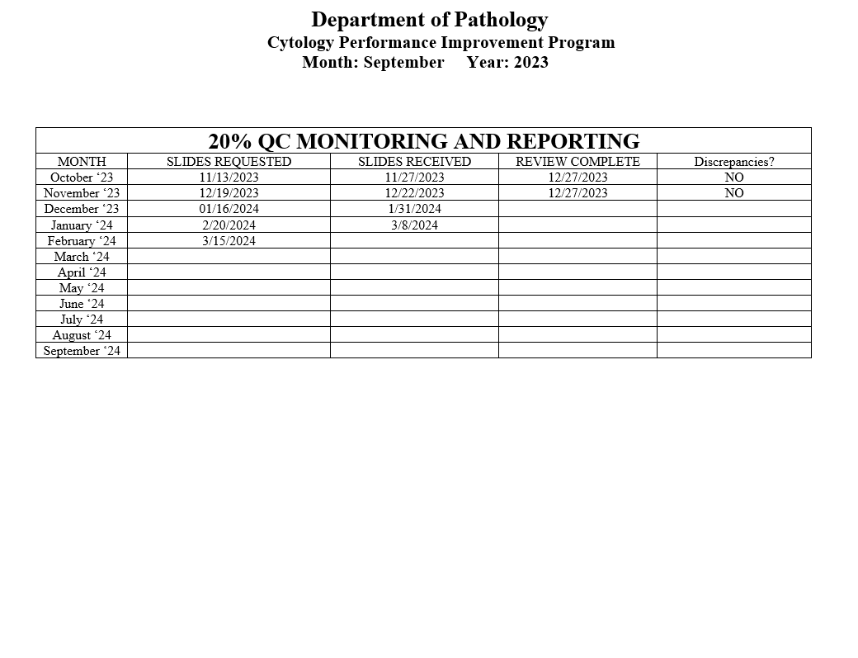
Notes:
The NON GYN TAT is due to staffing issues at YSM, extended leaves, vacations, and cross training in processing. May impact June.
We are up to date on QC review, April and May are with Dr. Cohen. We’ve had no discrepancies.

Slide 25
Competency Checklist
\\Ynhh.org\src\BH - Laboratory\AP - BH 38030\! AP QA\AP QA Meetings\COMPETENCY LOG TO UPDATE MONTHLY\Monthly Competency.xlsx

Slide 26
Reports:
Policy and Procedures for signature Review (ongoing)
Ongoing...
PM for all other equipment
\\Ynhh.org\bh\Laboratory\AP - BH 38030\Maintenance & Service Reports\Current Instrument List.xlsx

Slide 27
Non-Conforming Events
\\Ynhh.org\src\BH - Laboratory\AP - BH 38030\! AP QA\AP QA Meetings\Irreplaceable Specimen Templates\IS Update for BH goals 2024 presentations\IS Update for BH goals month of February 2024.pptx

Slide 28
New Business
SAFER event for AP- None for January
Equipment: Tissue Processor- Peloris & embedding station- Arcadia
Personnel Update
Pathology Candidate
Students (HTL, PA)
Cytology
Recognition

